Slide 1
Contract Management

Slide 2
What is a Contract?
A contract is a legal and binding instrument governing the responsibilities of both parties in which an offer is made and accepted, and each party benefits
Remember…….. Purchase Orders are considered to be a Legal Binding Contract

Slide 3
What does a contract consist of?
Agreements
Terms & Conditions
Contracts can be one (1) page or multiple pages.
Contracts can be on-line versions like software agreements (i.e. when you click “I Accept.”)
You should not agree to the terms of on-line agreements (i.e. for software or IT related purchases) until they are reviewed and approved by ITS and Purchasing

Slide 4
Who can sign contracts?
Ability to sign contracts is restricted to a limited number of University individuals
Department Heads Cannot sign contracts
If you sign a contract you can be held personally liable
Approval matrix is available on the Controller’s website.

Slide 5
What can you Help us look out for in Contracts?
Contract Length (Only 12 months)
No Automatic Renewals
No Hold Harmless or Indemnification language
No additional charges or fees such as tax, late payment or interest
No Jurisdictions from any other state other than Georgia
No arbitration
No Prepayments or Deposits

Slide 6
What Contracts are available to use?
The State bids out contracts that we can use as a University System of Georgia Institution in forms of Mandatory SWC, Convenience SWC & IGA Contracts
We can also utilize Consortia & Cooperative Contracts through organizations such as NJPA, E&I just to name a few
Any contract totaling $25,000 or more must be competitively bid
All purchases between $5,000 - $24,999 not on a contract must have 3 quotes attached to the requisition

Slide 7
Is this on Statewide Contract?

Slide 8
Any Service $2,500 and above must complete a E-verify and attach it to the requisition or check request.
What is an E-verify?
E-Verify is an Internet-based system that compares information from the U.S. Department of Homeland Security and Social Security Administration to confirm employment eligibility
Federal Law requires UWG to have an E-Verify for all transactions when any labor or services ("the physical performance of services") greater than $2,499.99 are procured or contracted for
The affidavit must be obtained prior to the service being contracted for or procured, except in the case of emergency repairs or services.

Slide 9
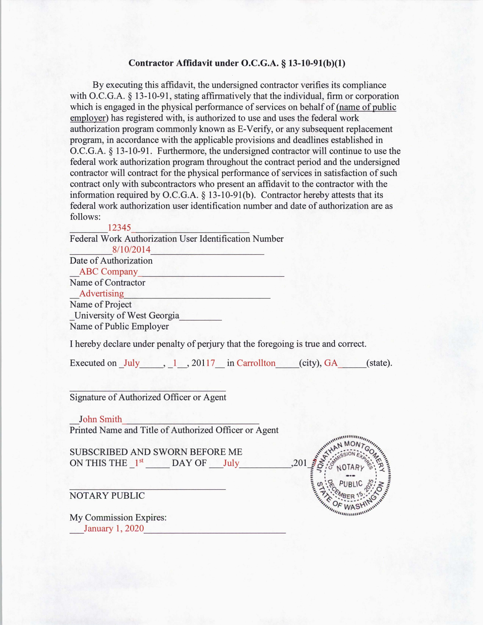
E-verify number is not your SS# or FEIN#
5-7 digit number
E-verify’s must be Notarized
If you need more information go to the Purchasing webpage

Slide 10
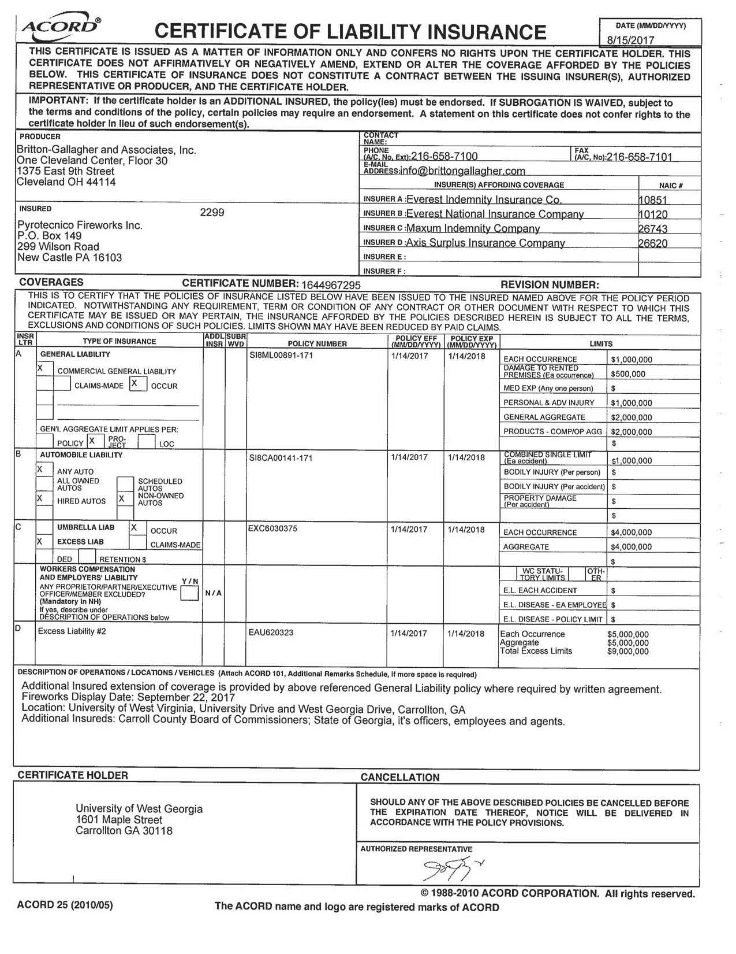
Certificates of Insurance
Anyone performing a service on State Property needs to provide a copy of their Certificate of Insurance
Certificates are good for 1 year
Policy Dates are listed, be sure your project will be completed before the expiration or we will need a new copy

Slide 11
Currently UWG does not buy any Weapons of Mass Destruction…… or do we? According to our Category / NIGP codes on our Requisitions we do ……

Slide 12
Category / NIGP Codes
There are over 9,000 codes for commodities and services
The codes will drive which account code is used, and also routes the Requisition to the Approvers
All services are listed under a 9XXXX code (So be sure to utilize the correct code)
All purchase orders are audited by the State on the Category / NIGP codes

Slide 13
What is an NIGP code

Slide 14
Take your time
Take your time to go through the list one day and make notes of where your purchases live
Make a quick list of codes you will use the most
If you can not find a number give your friendly purchaser a call and we are always Happy to Help! ☺

Slide 15
What will Purchasing Services Do?
Review all Purchase requests for compliance with State purchasing guidelines
Review all contracts, to ensure they have the correct terms
Contact vendors for changes, if necessary
Process Contracts
Secure Signatures
When planning ahead, you should submit any contracts ahead of time for review prior to the purchase request being submitted.

Slide 16
In Conclusion …….
Do not sign anything!
Obtain electronic copies of contracts if possible
Submit to Purchasing ASAP for review
Ask for an E-verify or Certificate of Insurance
Plan ahead!!!

