Slide 1
Wolf Watch A Degree Evaluation and Advising Tool University of West Georgia
Notes:
Hello, this is a tutorial which will outline how to access and interpret Wolf Watch, UWG’s online degree audit system.

Slide 2
What Wolf Watch is
AKA Degree Works
Ellucian 3rd party software
Integrates with Student Information System
Web-based tool for schedule planning and degree audit
Tracks degree progress
Prepares for registration
Plans for graduation
Maintains record of advisement notes & schedules
Aids in academic advising and program planning
Notes:
Wolf Watch, trade name, Degree Works, is a 3rd party software owned and developed by Ellucian, the company that provides Banner, our student information system.
Wolf Watch is a stand-alone software in which Banner student information must be loaded. Changes to student records, such as grades and class registration, must be bridged into Wolf Watch. This is accomplished each evening by an automated process. There is also a manual option that will be demonstrated later in this tutorial.
Wolf Watch tracks students’ progress toward a degree and can assists in generating a plan for students to follow in order to graduate within a pre-determined time-period.
The system may also be developed to determine if the student is off-track in following the pre-determined plan. Additionally, the plan may be modified to accommodate changes to the students plan.

Slide 3
What Wolf Watch is not
Replacement for face-to-face advising
Process to change student records
Discussion forum
Option to post questions to request clarification
Method to track certificates
Perfect
Notes:
Wolf Watch is not intended to replace face-to-face academic advising but rather a web-based tool to assist in the advising process. While there is an option to include advising notes, WW is not the best method to facilitate the processes listed.
And, because of the variety of student records, the system can’t be all things to all students. Because of courses that may fulfill more than one requirements, individual adjustments may be necessary to assure these multi-use courses are applied to the student’s worksheet in the most beneficial way.

Slide 4
Who Can Use Wolf Watch?
ADVISORS – Faculty & Professional
STAFF – Clerical & Registrar
STUDENTS
All currently enrolled undergraduate students who matriculated Fall 1998 or after
Currently enrolled undergraduate students who matriculated before Fall 1998, with UWG quarter coursework enrolled in specific degree program (requires manual adjustments)
Currently enrolled graduate degree-seeking students
Notes:
Enrolled, degree-seeking students automatically have access to view their individual Wolf Watch degree audit.
Some UWG staff members have been granted limited access to assist students and advisors in the academic advising process.
All faculty and professional advisors may gain access to Wolf Watch to review student records. If you are an active faculty member or designated as a professional advisor and do not currently have access to Wolf Watch, you are eligible to request access.

Slide 5
Benefits
User friendly and easy to understand format
Students and advisors will have the ability to develop long-range degree completion plans
Streamlines the graduation process
Helps students spend less time deciphering degree requirements and more time pursuing their academic goal
Notes:
The benefits of using an online degree audit tool are many and varied beyond the almost 24/7 access.
Wolf Watch provides one document to gather and arrange a variety of necessary information in a style that is user-friendly and formatted to high-light missing requirements.
Students gain a clear understanding of what requirements have been completed and which courses they will need in the future to complete all requirements and earn a degree.

Slide 6
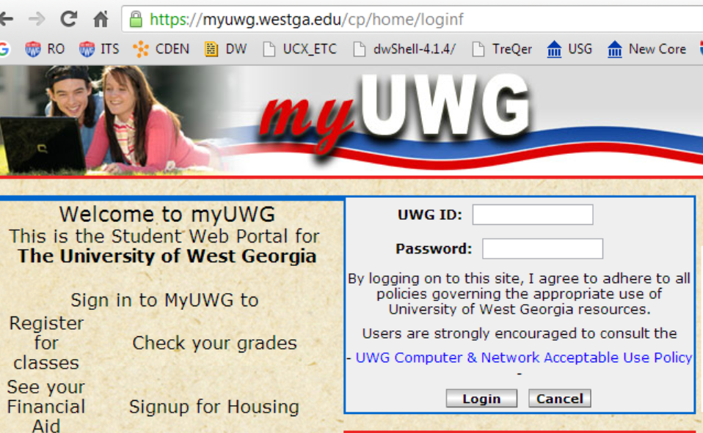
Network ID/user
Network password
Advisor login:
Banweb using 917 and banweb password
MY UWG Portal using Network credentials
Direct URL https://hank.westga.edu/
ID is 917, password is last 2 birth year, last SS#
Notes:
Advisors may access Wolf Watch via their myUWG portal, directly from Banweb, or using the URL.

Slide 7
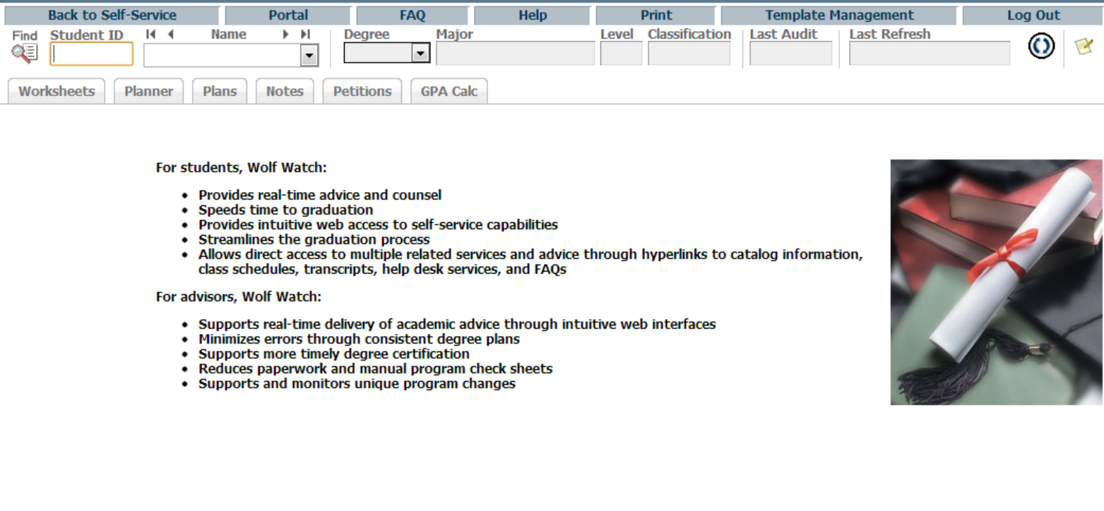
ADVISOR VIEW
Enter selected student ID in the field provided and hit enter, and worksheet for selected student is now viewable.
*Note—the worksheet may take several seconds to load.
Notes:
Advisors may directly enter the student’s ID number in the field provided and hit the Enter key on your keyboard. Note that the worksheet may take several seconds to load depending upon the volume of user request to the system.

Slide 8
Search for a student by name or a population of students by one or more common fields from the menus.
Notes:
If you don’t know the student’s ID number or if you would like to select a population of student to view without having to enter each students ID number you may use find button.

Slide 9
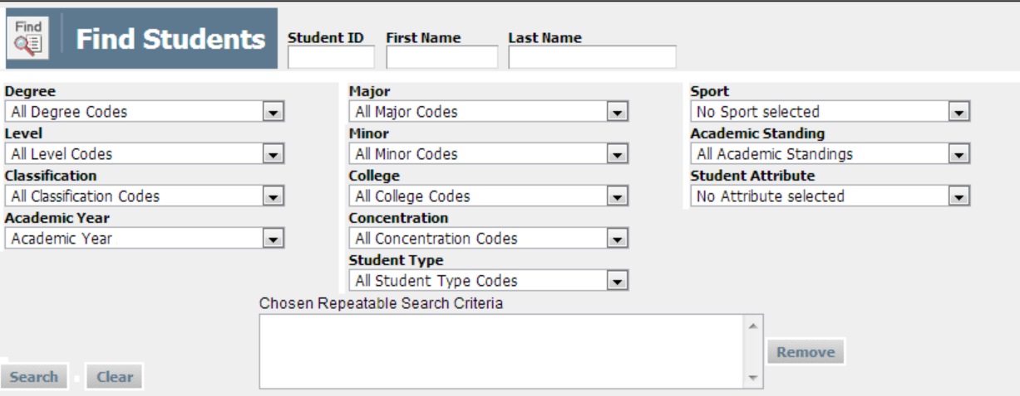
Enter student name or select one or more fields. Returns a list of all active students by data fields entered. List appears in the lower block.
Notes:
A list of filters is provided to either enter the student’s name or generate a list of students with the same criteria. Entering the fields narrows the list to only active students with the particular criteria selected. The list of students with the criteria selected will populate the lower block. The system is set to only return a maximum of 200 students so you may need use multiple fields to narrow the search.
Select the OK button to return the complete list or use the uncheck option to select only certain students and then select the OK button

Slide 10
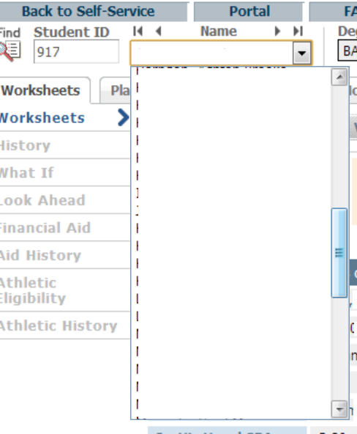
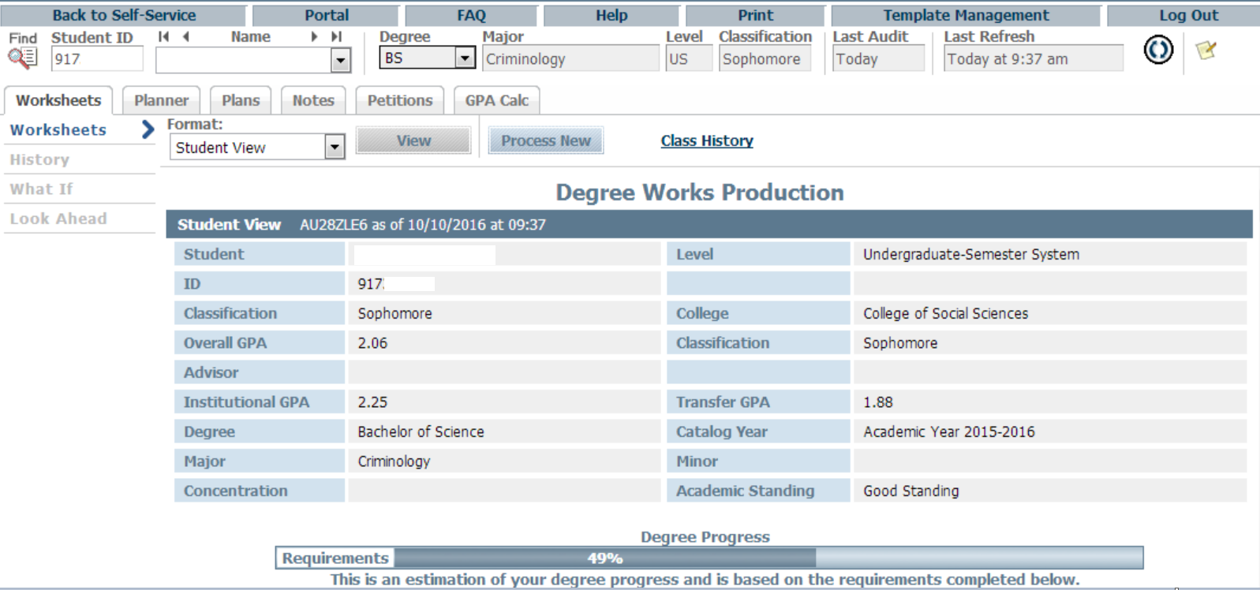
Notes:
If you select a list of students, only the first student name will populate the worksheet but you can use the drop-down menu button to review and scroll through the list of names that fit the criteria selected. Names have been redacted for this demonstration.

Slide 11
Last Refresh Date
Last Audit Date
Notes:
Either selecting a student by ID or the find option, you will review their individual worksheet. Notice the Last Refresh and Last Audit dates. Remember that student records must be loaded into Wolf Watch. You may choose to review the current audit or refresh and process a new audit with the most recent information.

Slide 12
Refresh
Process New
Notes:
Selecting the radio button to the right of the last refresh field will re-bridge the current student information from Banner. Then selecting the Process New button will generate a new audit with the refreshed information. The update must be in this order, refresh, then process new.

Slide 13
Legend & Disclaimer
Explains the status of classes
Interpret the symbols
Wolf Watch does not replace face-to-face advising
Notes:
Review the legend for an explanation of the symbols used in the worksheet
Also review the disclaimer , Wolf Watch is a tool, not to be considered a legal contract, but a guideline for degree requirements.

Slide 14
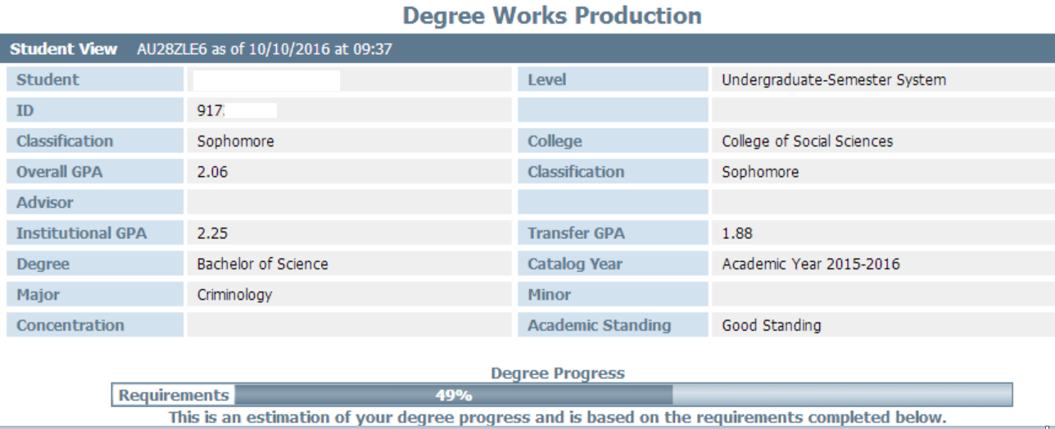
The Degree Progress Bar
Estimation of progress toward degree completion based on the number of requirements that have been met.
For pre-majors or undeclared students, it will be based only on their first two years of coursework.
Notes:
The degree completion bar is an estimate toward completion. The bar will only be 100% when all of the requirements within the worksheet are complete. 100% completion is not to be an absolute indication that a degree will be awarded. There may be additional information not included within the worksheet.

Slide 15
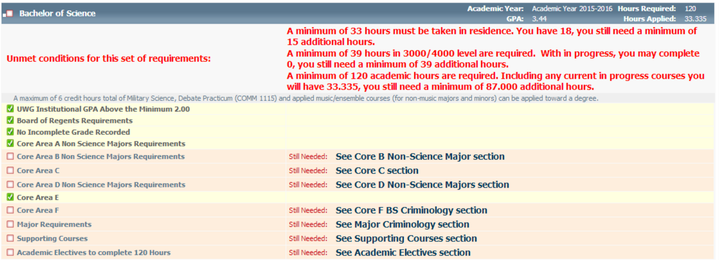
Information Blocks
Overall Degree Block: hours used in worksheet including in progress, upper-level hours, worksheet GPA, information blocks.
Notes:
The worksheet is broken down into blocks of information. The top block, or parent block lists the general top tier requirements and a list of the individual information blocks.
Each block has an information header.
Additional text is included for any unmet requirements.

Slide 16
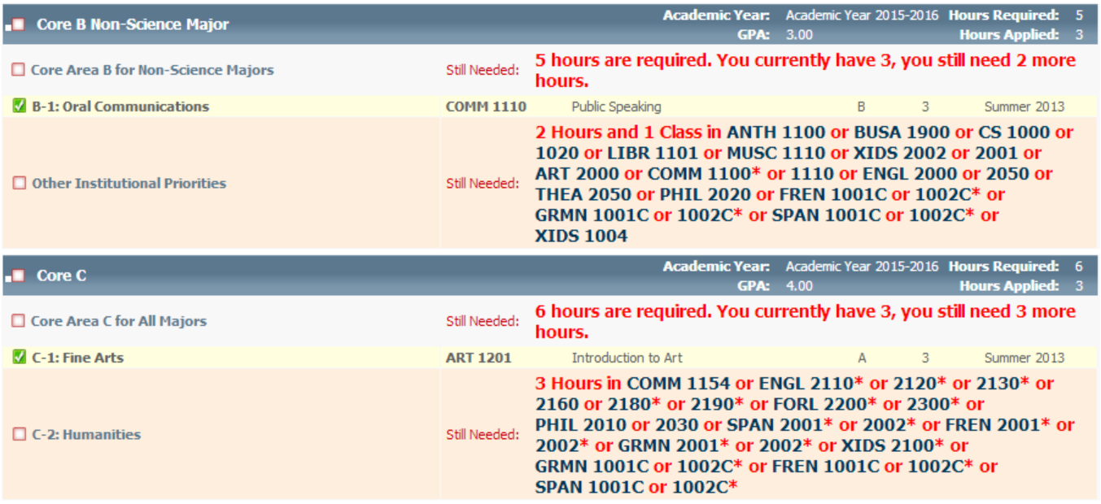
Individual Blocks:
Core Areas
Supporting Courses
Major
Electives
Minor
DSW
Notes:
The individual information blocks are broken down according to each program and will include core areas and the major block. Some programs will have additional blocks of information that may include electives, minor, supporting courses and the Discipline Specific Writing,

Slide 17
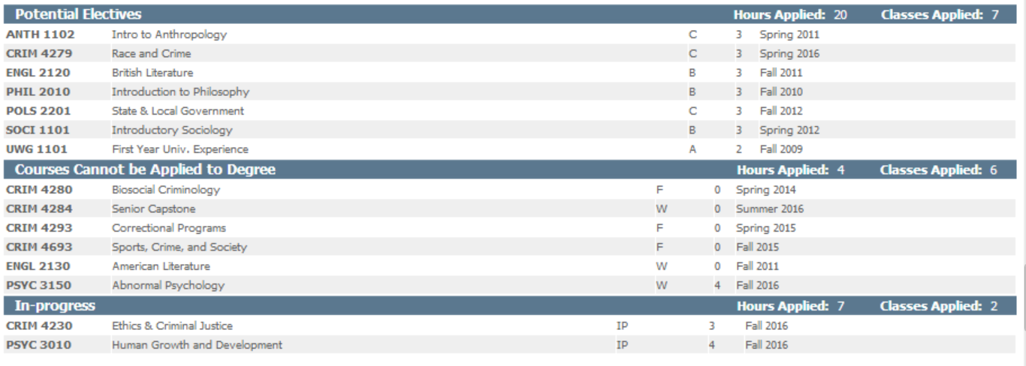
Potential Electives
Ineligible Courses
In Progress Courses
Notes:
Additional information may be available after the final information block. Not all audits will have these additional lines of information.

Slide 18
Important Information
Wolf Watch priority system for assembling courses into areas is not a mathematical algorithm
Graduation Candidates
Adjust multi-use courses
Missing requirements expecting petition for an exception
Review with academic advisor
For concerns pertaining to Wolf Watch, please visit the Enrollment Services Center in Parker Hall or contact the Registrar’s Graduation Team at graduation@westga.edu or (678)839-6438.
Notes:
Please carefully review the additional general and contact information.
This concludes this advisor tutorial for UWG’s Wolf Watch degree audit. Additionally, departments or advisors may request individual in-depth training sessions.

