Slide 1
Introduction to Search Engine Optimization (SEO)
Improving the visibility of our website in search engines’ organic search results.
Notes:
Author: Wesley Steverson 07-16-2013

Slide 2
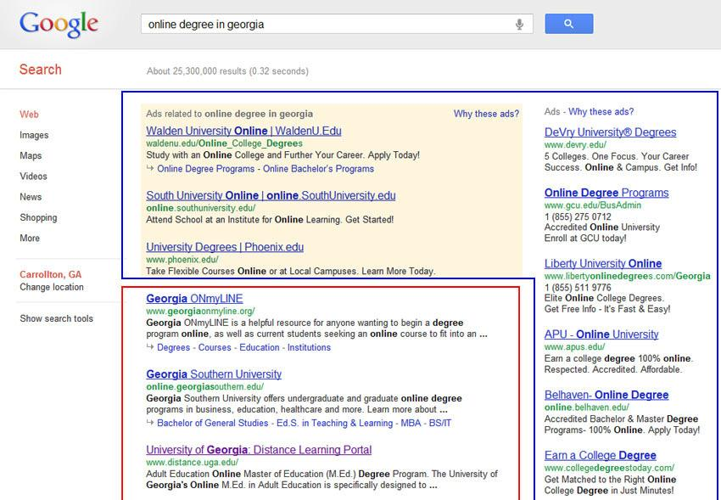
Organic vs. Paid Search
“Paid” Search Adwords ~20% of Clicks
Organic Search ~80% of Clicks
Notes:
Author: Wesley Steverson 07-16-2013

Slide 3
The Purpose of a Search Engine
1. Crawling and Indexing Through links, search engines’ automated robots, called “crawlers,” or “spiders” can reach the many billions of interconnected documents. Once the engines find these pages, they decipher the code and store select pieces in massive hard drives, to be recalled later.
2. Retrieving Answers
When you perform a search, search engines scour the billions of stored documents and do two things – first, return those results that are the most relevant to your query, and second, rank those results in order of perceived importance.
Notes:
Author: Wesley Steverson 07-16-2013
Relevance is the degree to which the content of the documents returned in a search matches the intention and terms of the user’s query. Importance refers to the relative importance, measured via citation (the act of on work referencing another, as often occurs in academic and business documents), of a given document that matched the user’s query.
The Art of SEO

Slide 4
How People Interact with Search Engines
The Search Process:
Experience the need for an answer, solution or piece of information.
Click on a result.
Scan the content of the webpage for a solution, or a link to that solution.
Formulate the need in a string of words or phrases (the query).
If unsatisfied with the webpage, return to the search results and browse for another link or…
Enter the query in the search engine and execute.
Browse through the results for a match.
Perform a new search with refinements to the query.
Notes:
Author: Wesley Steverson 07-16-2013

Slide 5
How People Interact with Search Engines
1. Navigational Queries Navigational searches are performed with the intent of surfing directly to a specific website.
2. Informational Queries
Informational searches are primarily non-transaction-oriented; information itself is the goal and no interaction beyond clicking and reading is required.
3. Transactional Queries
Transactional searches don’t necessarily require a purchase to be made. Signing up for a free trial or requesting a pamphlet are considered transactional.
When visitors type a query into a search box and land on our site, will they be satisfied with what they find?
Notes:
Author: Wesley Steverson 07-16-2013

Slide 6
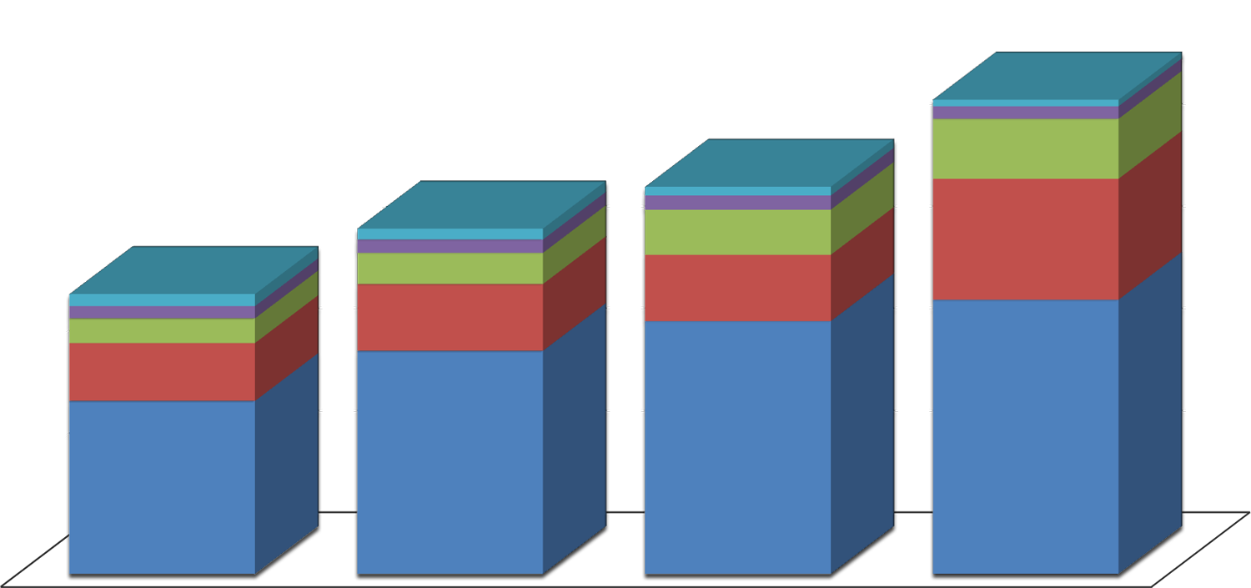
Why SEO?
U.S. Search Volume Growth (MM)
250,000
Google Sites
Yahoo! Sites
200,000
Microsoft Sites
150,000
Ask Network
100,000
AOL, Inc.
50,000
0
2008
2009
2010
2011
Data via Comscore Qsearch http://www.comscore.com
Notes:
Author: Wesley Steverson 07-16-2013
Totals: 2008 2009 2010 2011
Google 84,620 109,114 123,616 134,100
Yahoo! 28,329 32,670 32,459 59,186
Microsoft 12,070 15,208 22,043 29,325
Ask 5,995 6,536 6,947 6,134
AOL 5,870 5,357 4,291 3,171
TOTAL 136,900 168,895 189,381 204,921

Slide 7
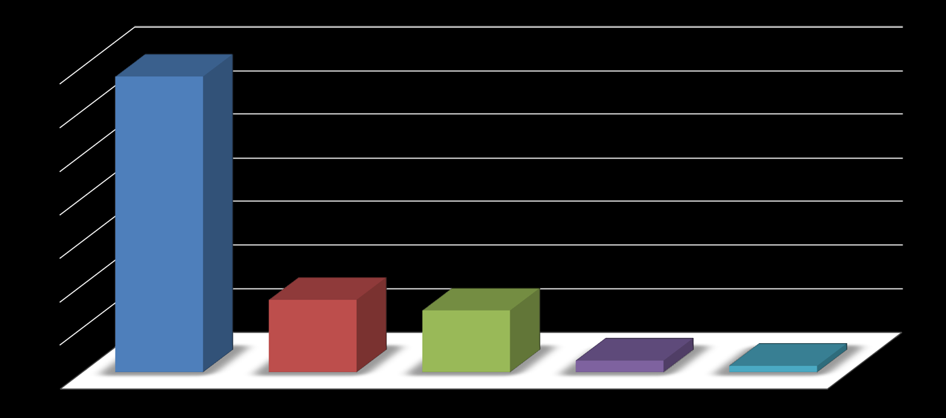
Why SEO?
Total Search Query for January 2012 (MM)
Americans conducted nearly 20 billion total core search queries in January!
14,000
12,000
10,000
8,000
6,000
4,000
2,000
0
Google Sites
Microsoft Sites
Yahoo! Sites
Ask Network
Ask Network
AOL, Inc.
AOL, Inc.
Data via Comscore Qsearch http://www.comscore.com
Notes:
Author: Wesley Steverson 07-16-2013
“Total Core Search” is based on the five major search engines, including partner searched, cross-channel searched and contextual searched. Searched for mapping, local directory, and user-generated video sites that are not on the core domain of the five search engines are not included in these numbers.
Google Sites: 13,218
Yahoo! Sites: 3,191 Microsoft Sites: 2,761
Ask Network: 527
AOL, Inc.: 277

Slide 8
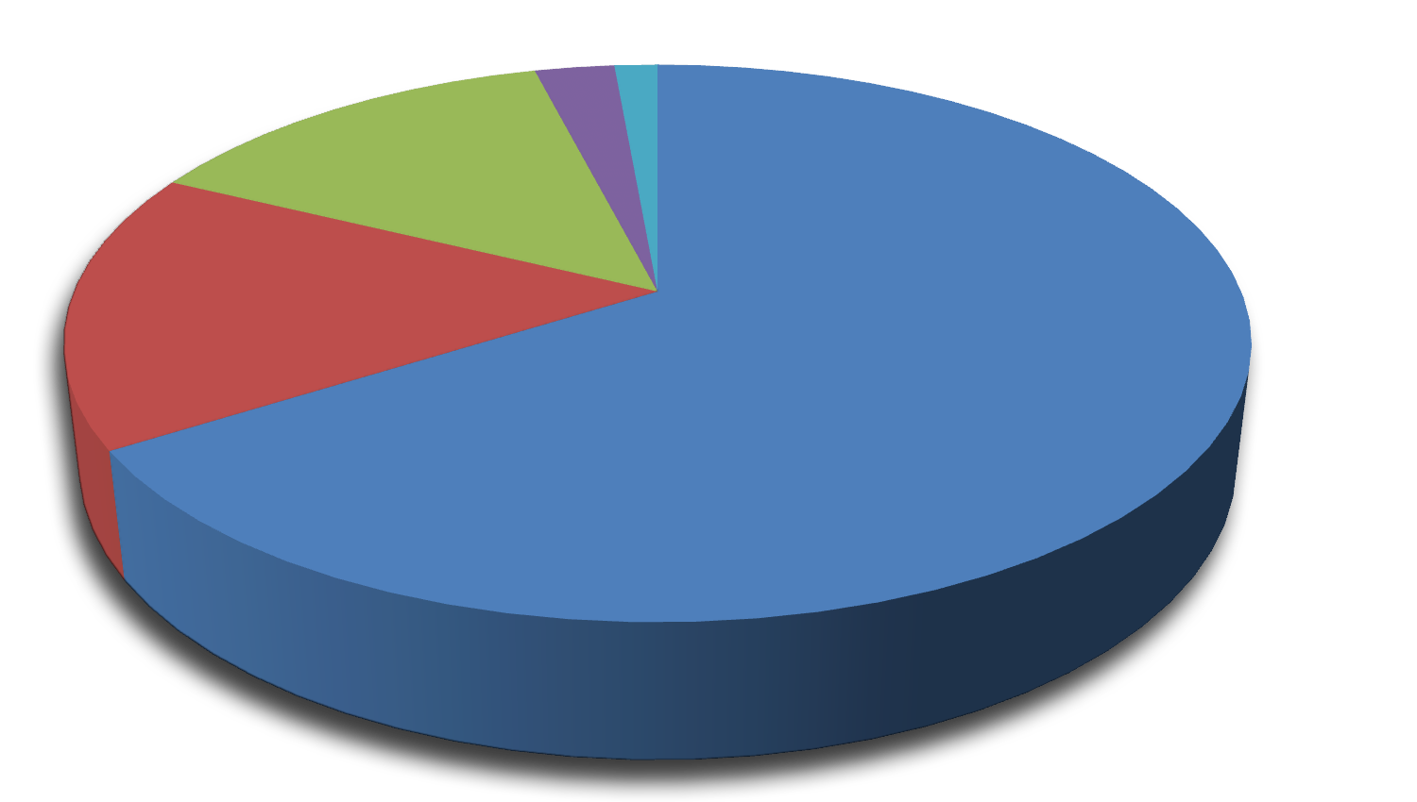
Why SEO?
Total Search Share for January 2012 (%)
2.6%
1.4%
13.8%
Google Sites
16.0%
Yahoo! Sites
66.2%
Microsoft Sites
Ask Network
AOL, Inc.
Data via Comscore Qsearch http://www.comscore.com
Notes:
Author: Wesley Steverson 07-16-2013

Slide 9
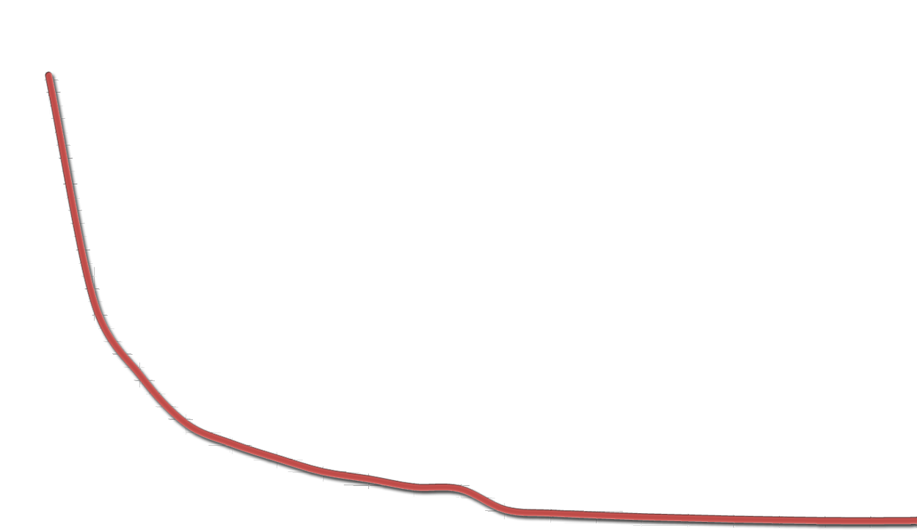
Why SEO?
Organic Click Through Rate (CTR)
Google Result | Impressions | Percentage
1 | 2,834,806 | 34.35%
2 | 1,399,502 | 16.96%
3 | 942,706 | 11.42%
4 | 638,106 | 7.73%
5 | 510,721 | 6.19%
6 | 416,887 | 5.05%
7 | 331,500 | 4.02%
8 | 286,118 | 3.47%
9 | 235,197 | 2.85%
10 | 223,320 | 2.71%
40%
35%
30%
25%
20%
15%
10%
5%
0
1
2
3
4
5
6
7
8
9
10
11
12
13
14
15
16
17
18
19
20
http://insights.chitika.com/2010/the-value-of-google-result-positioning/
Notes:
Author: Wesley Steverson 07-16-2013
Numbers are based on a sample of 8,253,240 impressions across the Chitika advertising network in May, 2010.

Slide 10
Golden Rule of SEO
When building or modifying your website – whether your adding images, restructuring your links, or changing your written content – always base your decisions on improving the user’s experience.
Notes:
Author: Wesley Steverson 07-16-2013

Slide 11
On Page SEO
Basic Practices
Title Tag
Meta Keywords
Meta Description
Usability
Image Alt Tag
Files Names
Media Description
Structure
URL
Subdomains
Navigation
Content
Anchor Text
Heading Tags
Keywords
Notes:
Author: Wesley Steverson 07-16-2013

Slide 12
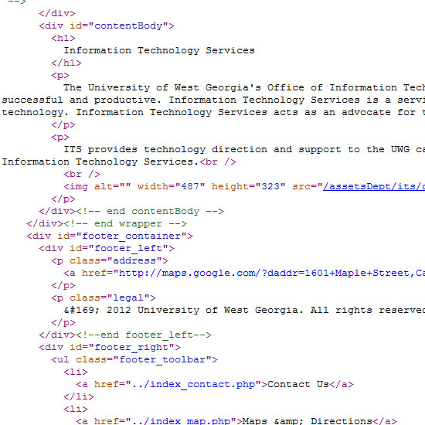
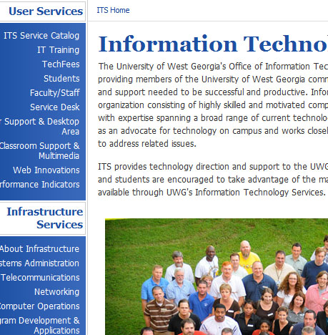
On Page SEO – What does the search engine see?
How the User sees the webpage.
How the Search Engine sees the webpage.
Notes:
Author: Wesley Steverson 07-16-2013

Slide 13
On Page SEO – Basic Practices
1. Title Tag:
Make sure the title tag on each page of the site is unique and descriptive. It should be no longer than 65 characters. If possible, place your keywords in the title tag.
2. Meta Keywords:
These keywords no longer carry much weight with search engines. You can use the meta keywords to help emphasize the content keywords you would like to focus on.
3. Meta Description:
Search engines use the meta description tag to describe your web page. Make sure every page has a unique description. It should be no longer than 160 characters.
Notes:
Author: Wesley Steverson 07-16-2013

Slide 14
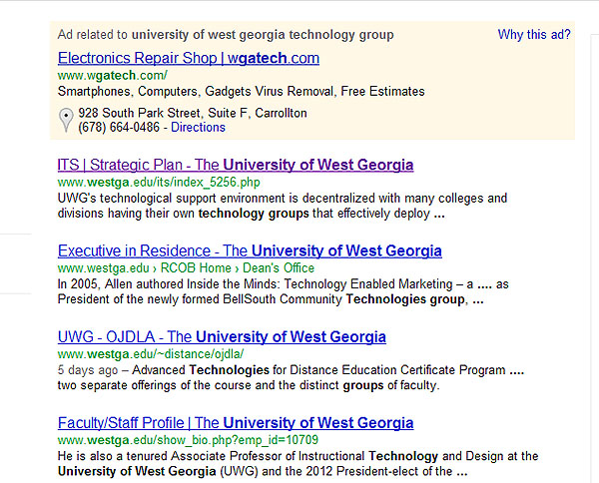
On Page SEO – Basic Practices
Title Tag Example
Meta Description Example
Notes:
Author: Wesley Steverson 07-16-2013

Slide 15
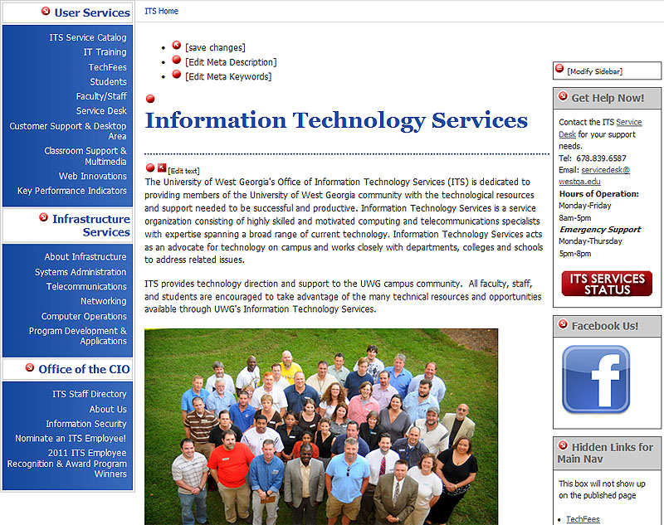
On Page SEO – Basic Practices
Meta Description
Meta Keywords
Title / Title Tag
Notes:
Author: Wesley Steverson 07-16-2013

Slide 16
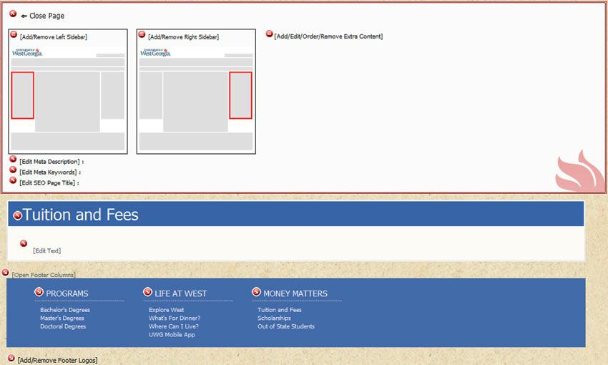
On Page SEO – Basic Practices
Meta Description
Meta Keywords
Title Tag
Title
Notes:
Author: Wesley Steverson 07-16-2013

Slide 17
On Page SEO – Usability
Usability is a reference to how easy it is for a user to accomplish what she wants on a website.
1. Image Alt Text:
A place where you can provide more information about what is in the image and where you can target keywords.
2. File Names:
Search engines look at the filename to see whether it provides clues to the content of the file.
3. Media Description:
A description helps the user and search engines better understand the content contained in your video, animation, etc.
Notes:
Author: Wesley Steverson 07-16-2013

Slide 18
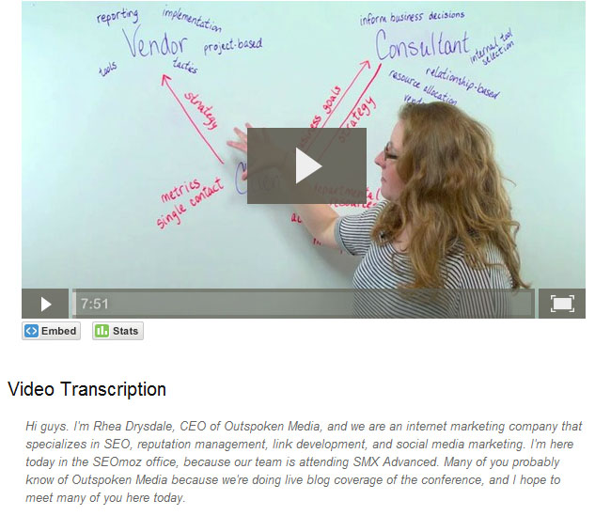
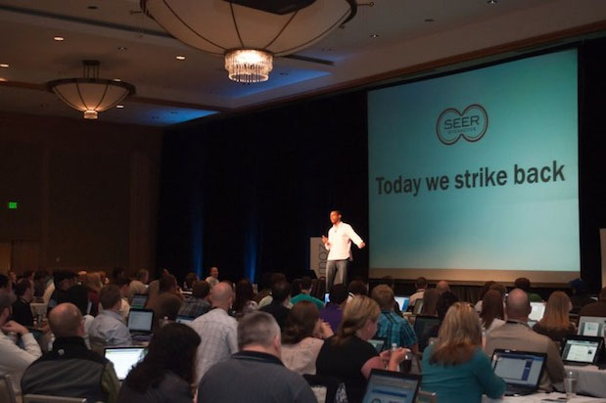
On Page SEO – Usability
Media Description
Image Alt Text & File Name
Examples from: http://www.seomoz.org
Notes:
Author: Wesley Steverson 07-16-2013

Slide 19
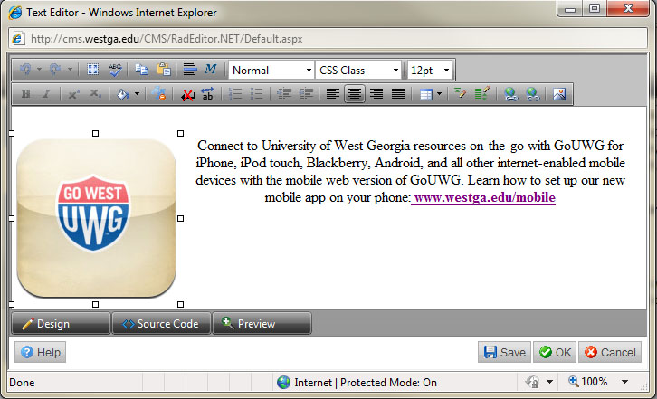
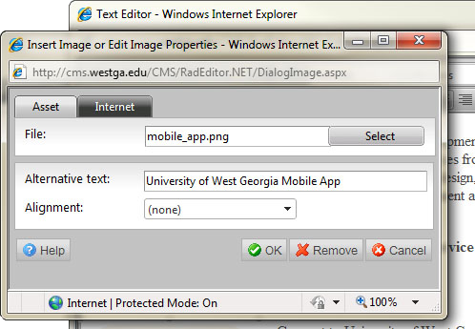
On Page SEO – Usability
File Name
Image Alternative Text
While the image is selected in the ‘Edit Text’ window (indicated by the white boxes); click the Insert/Edit Image button in the toolbar.
Notes:
Author: Wesley Steverson 07-16-2013

Slide 20
On Page SEO – Structure
1. URL’s:
Keeping your URL’s short and descriptive of your content will improve the user experience and lead to better crawling of your website by search engines. (Currently there is no way to change the URL in OpenText)
2. Subdomains:
A subdomain can look more authoritative to users and provide a reasonable choice to include keywords in the URL. Unfortunately, they have the potential to be treated separately from the primary domain when it comes to trust value.
3. Navigation:
Ordering your navigation in a logical and concise manner will assist the user (they will find the site easier to use) and search engines award greater ranking based on increased subject relevance.
Notes:
Author: Wesley Steverson 07-16-2013

Slide 21
On Page SEO – Structure
URL
Subdomains
www.westga.edu/its/wireless-login.php
http://uwgonline.westga.edu
www.westga.edu/its/v66613-thjukl.php
http://university.web.learning.westga.edu
Navigation
Notes:
Author: Wesley Steverson 07-16-2013

Slide 22
On Page SEO – Content
1. Anchor Text: The actual text placed in a link. If the text is keyword-rich, it will do more for your rankings in the search engines.
2. Heading Tags:
These tags are designed to indicate a headline hierarchy on the webpage. Search engines show a slight preference for keywords appearing in heading tags.
3. Content Keywords:
One of the most important on page SEO practices. When a user performs a query, the more relevant a keyword (or phrase) is to the query, the higher ranking the webpage will be in the search engine’s results.
Notes:
Author: Wesley Steverson 07-16-2013

Slide 23
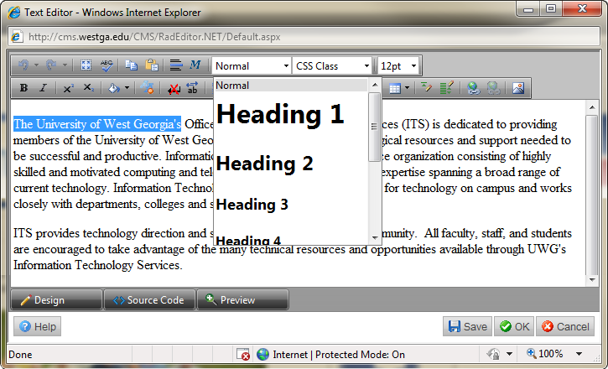
On Page SEO – Content
Anchor Text
Heading Tags
An active international student organization consists of…
After selecting the text (indicated by the blue highlight), use the drop-down to choose the header you would like to apply
If you are interested, click here…
Completed application with a non-refundable fee.
…and the Student Handbook, as amended.
Notes:
Author: Wesley Steverson 07-16-2013

Slide 24
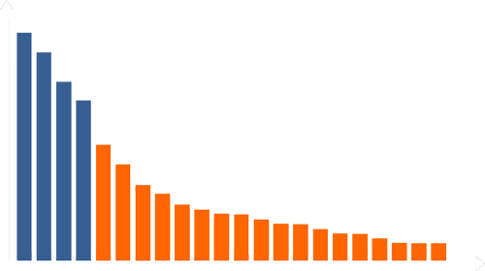
On Page SEO – Content
Keywords – Short Tail / Long Tail
The “Head” of the search demand curve
Thousands of queries per day
The “Long Tail”
<1 query per week
Popular queries University
Degree Scholarship
“Long Tail” queries UWG Wolfden’s serving hours
freshmen scholarships for education majors
Application to book Wolfie for a party
Notes:
Author: Wesley Steverson 07-16-2013

Slide 25
On Page SEO – Content
Keywords - Research
Make a list of one- to three- word phrases related to your website.
Produce synonyms that might be used by potential students.
Create a directory of all the people, projects, ideas, and companies connected to your site.
Review your current site and extract current key phrases.
Review websites associated with UWG and / or media sites to see what phrases they use.
List all your program names, products, and other services provided.
Have your department imagine they are potential students. What would they type in to find you?
Ask students and people outside your department what they would search for.
Review your competitors’ websites and see what key phrases they use.
Consider including your competitor’s non-branded terms for use in your keyword list.
Notes:
Author: Wesley Steverson 07-16-2013

Slide 26
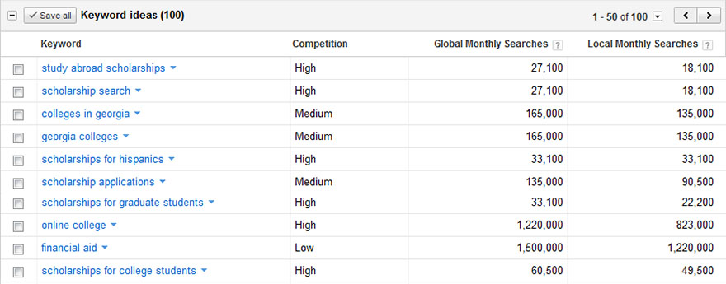
On Page SEO – Content
Keywords – Google Adwords
The Best Keywords Are:
High Volume (many searches/month)
Low Competition (weak sites in the top 10)
High Value (Large % of visitors convert)
https://adwords.google.com/select/KeywordToolExternal
Notes:
Author: Wesley Steverson 07-16-2013

Slide 27
On Page SEO – Content
“Good” Content
VS.
“GREAT” Content
Satisfies the searcher’s basic information requirements
Surprises and delights the searcher by being remarkable
Written by a human and not duplicated elsewhere
Produced by extraordinary writers and designers
Long enough to fulfill basic needs of engines for depth/uniqueness
May leverage video, audio, graphics & photos to convey a unique, shareable experience.
Grammatically correct; free of spelling / punctuation errors
Produced by extraordinary writers and designers
Notes:
Author: Wesley Steverson 07-16-2013

Slide 28
Off Page SEO
Links
Link influence on search engines
Link Value
Social Media
Social Media Sites
Indirect Influence of Social Media
Other
Sitemap
DMOZ
robots.txt
Google mini
Notes:
Author: Wesley Steverson 07-16-2013

Slide 29
Off Page SEO – Links
Link Influence on search engines
Links remain the single largest factor in determining search ranking.
PageRank algorithm
External links on a webpage can be interpreted as votes.
Initially, all votes are considered equal.
Over the course of time, pages which receive more votes become more important.
More important pages cast more important votes.
Votes per Page = Page Importance / Number of Links.
PageRank
Passable PageRank
Passable PageRank
Passable PageRank
Notes:
Author: Wesley Steverson 07-16-2013

Slide 30
Off Page SEO – Links
Link Value
Anchor Text: Search engines use the anchor text to help it understand what the page receiving the link is about.
Relevance: Links that originate from sites/pages on a closely related topic are worth more.
Authority: A site with higher authority will pass along more PageRank. However, search engines will not tell you which sites they consider authoritative.
Trust: Trust of a websites takes into account whether the linking page or the website is easy or difficult for spammers to infiltrate. The trust level of a site is based on how many clicks away it is from one or more ‘seed’ sites.
Notes:
Author: Wesley Steverson 07-16-2013

Slide 31
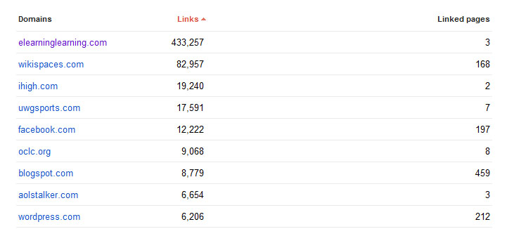
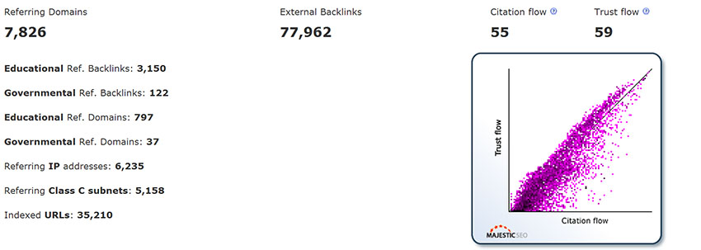
Off Page SEO – Links
www.google.com/webmasters/tools/
www.majesticseo.com
Notes:
Author: Wesley Steverson 07-16-2013

Slide 32
Off Page SEO – Social Media
Wikipedia Profile
StackExchange Account
Facebook Department Page
StumbleUpon Account
Twitter Profile
Reddit Account
Linkedin Company Page
SlideShare Profile
YouTube Account
Scribd Profile
Crunchbase Page
Google Profile
About.me Page
Quora Profile
Notes:
Author: Wesley Steverson 07-16-2013
CrunchBase is the free database of technology companies, people, and investors that anyone can edit.
Quora: Connects you to everything you want to know about. when you want to know something, Quora delivers you answers and content from people who share your interests and people who have first-hand knowledge. About.me: Create one page website that’s all about you and your interests. Scribd: for social reading and publishing
Reddit: Redditors vote on which stories and discussions are important. The hottest stories rise to the top.
StumbleUpon: Tell them what you like and they’ll introduce you to amazing web pages, videos, and photos and more that you wouldn’t have found on your own.
StackExchange: Provides expert answers to your questions.. 85 question and answer sites on diverse topics.

Slide 33
Off Page SEO – Social Media
Benefits of Social Media
It Cost Nothing to Get Started For just a little bit of time and creativity, you can create department and personal pages and keep students informed of new programs.
Blogs are Simple to Create You can create targeted content that focuses on your SEO content keywords.
Results Can Be Faster Than Traditional Websites You have the opportunity to “go viral” with the content you post using social media.
Social Media Posts and Profiles are Included in Search Results All social media posts and profiles are opportunities to get your site noticed by search engines.
http://www.submitedge.com/blog/15-seo-benefits-of-social-media/
Notes:
Author: Wesley Steverson 07-16-2013

Slide 34
Off Page SEO – Social Media
Benefits of Social Media (continued)
You Can Get Ranked Higher Each time your content is shared, it creates a backlink to your content. This gives you more chances to have PageRank votes passed to your content.
There are Lots of Options Variety is the spice of life.
Social Media is Easy To Use You don’t need to dedicate a lot of time to social media – work on posting quality content and let other users do the work for you by sharing it with their friends.
It’s an Additional Platform for Content Westga.edu is usually a static, brochure website. With social media, you will be able to produce quality content that relates to you and your department.
http://www.submitedge.com/blog/15-seo-benefits-of-social-media/
Notes:
Author: Wesley Steverson 07-16-2013

Slide 35
Off Page SEO – Social Media
Benefits of Social Media (continued)
Builds Brand Awareness As you become more visible, as long as you continue to produce quality content, you will soon become an authority figure in your niche.
Has Unlimited Reach By participating in social media, you will be able to reach users that would have never stumbled upon the university’s website.
Puts Followers to Work for You Let other users share your quality content.
http://www.submitedge.com/blog/15-seo-benefits-of-social-media/
Notes:
Author: Wesley Steverson 07-16-2013

Slide 36
Off Page SEO – Other
XML / HTML Sitemap
A sitemap is a list of pages of a web site accessible to search engines and users.
Benefits of a Sitemap
Helps improve how often and the manner in which search engines crawl your website.
Search engines use additional URL’s to ‘discover’ pages they didn’t know about.
Verification / registration of XML Sitemaps may indicate positive trust / authority signals.
A HTML sitemap can further help a user navigate your website.
Notes:
Author: Wesley Steverson 07-16-2013

Slide 37
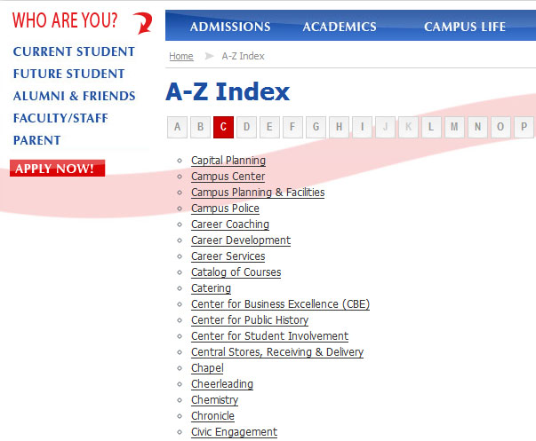
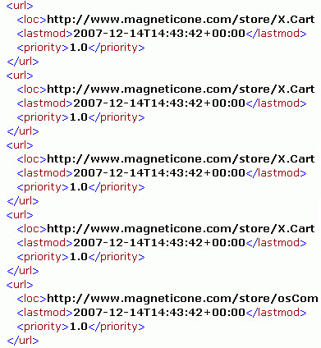
Off Page SEO – Social Media
XML / HTML Sitemap
XML Sitemap
HTML Sitemap
Notes:
Author: Wesley Steverson 07-16-2013

Slide 38
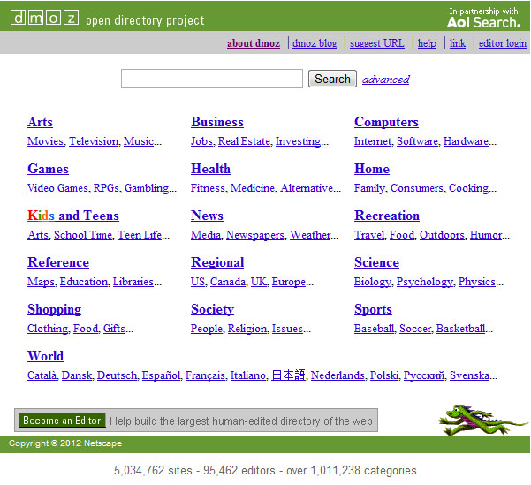
Off Page SEO – Other
DMOZ – Open Directory Project
“The Open Directory Project is the largest, most comprehensive human-edited directory of the Web. It is constructed and maintained by a vast, global community of volunteer editors.”
www.DMOZ.org
Notes:
Author: Wesley Steverson 07-16-2013

Slide 39
Off Page SEO – Other
robots.txt
This is a file that is located on the root level of our domain.
Benefits of robots.txt
Prevents search engines from accessing nonpublic parts of our website.
Block search engines from accessing out pages of code.
Avoid the indexation of duplicate content on our website, such as “print” or “mobile” versions of webpages.
Auto-discover Sitemaps.
Notes:
Author: Wesley Steverson 07-16-2013

Slide 40
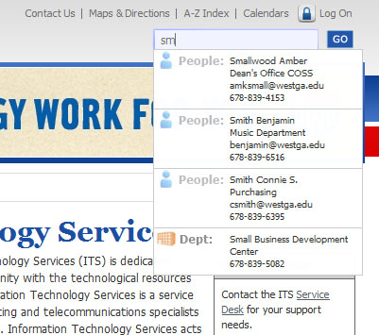
Off Page SEO – Other
Google Mini
Not everyone who enters our website is coming through the front door (homepage). The Google mini appliance helps user’s navigate deeper into our website without having to click their way through to the page they need.
Within the Google mini appliance, we have total control over page placement by keyword. This is a great internal opportunity to make your department’s website easier to find from anywhere in www.westga.edu
Notes:
Author: Wesley Steverson 07-16-2013

Slide 41
SEO Violations
Too much of a good thing can be bad for you, especially in SEO.
DO NOT over ‘keyword’ your content. Your content should be easy to read and not stuffed with the same terms over and over again.
DO NOT make sentences into anchor text. This could cause confusion on your site and make your content difficult to read.
DO NOT focus on keywords that are not associated with your site. This is a big no-no. If you try and get ranking in a popular keyword (such as ‘Free’) and it is not associated with your website, the search engine could black-list the site.
Notes:
Author: Wesley Steverson 07-16-2013

Slide 42
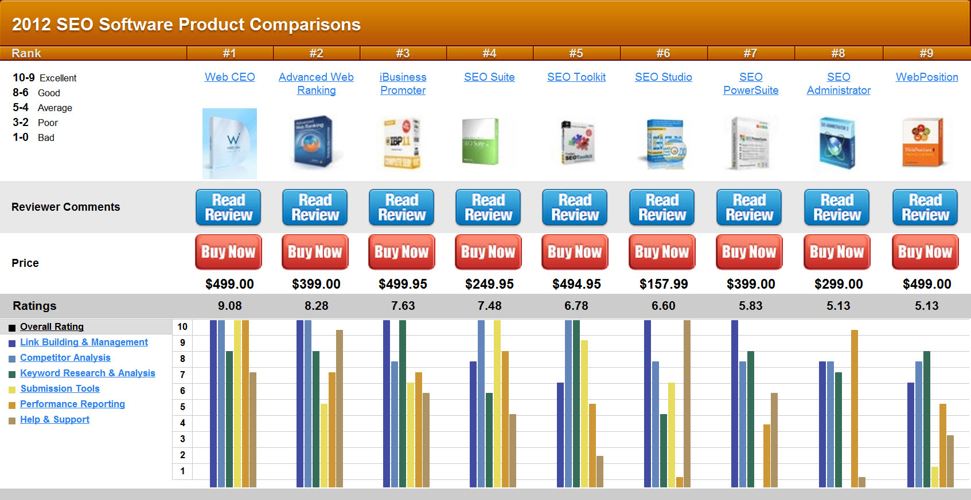
SEO Software
Notes:
Author: Wesley Steverson 07-16-2013

Slide 43
SEO Software
SEO Software Key Functionality
Stores and organizes your keyword objectives by project and page
Finds top ranked pages
Performs comparison analysis to rank your page against other pages
Make specific suggestions about how to improve you website
Identifies potential inbound link opportunities.
SEO Software Reviews:
www.topseos.com/rankings-and-reviews-of-best-seo-software
seo-software-review.toptenreviews.com
Notes:
Author: Wesley Steverson 07-16-2013

Slide 44
Tracking and Measuring Results
You cannot methodically improve what you cannot measure.
Notes:
Author: Wesley Steverson 07-16-2013

Slide 45
Tracking and Measuring Results
Define your Baseline
Use information from the below listed to establish a baseline of data points:
Organic search traffic by search engine and keyword
Major keywords that are driving traffic by search engines
A breakdown of which sections are getting current organic search traffic by search engine and keyword
To further enhance you baseline, include the following:
Identify poorly performing pages
Identify the best performing pages (in terms of traffic and conversion)
Track search engine crawler activity on the site
Determine the number of indexed pages and whether they are getting search traffic
Identify any error pages and external sites linking to these pages
Notes:
Author: Wesley Steverson 07-16-2013

Slide 46
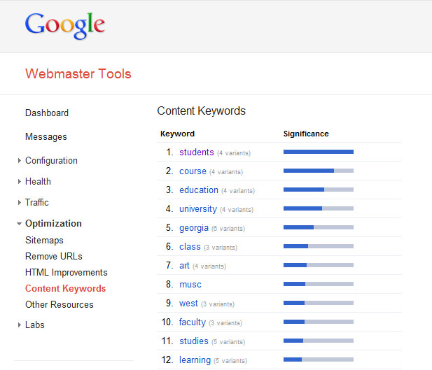
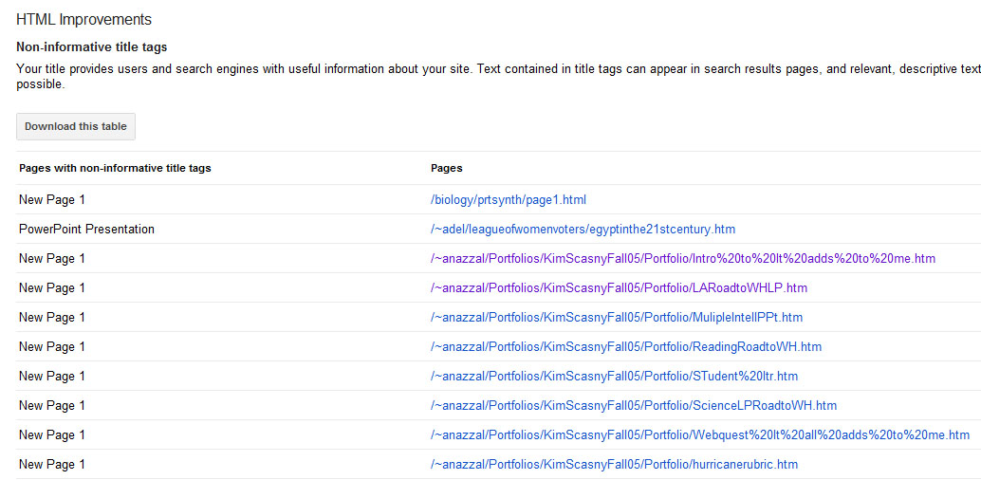
Tracking and Measuring Results
Webmaster Tools
Non-informative Title Tags
Content Keywords
www.google.com/webmasters/tools/
Notes:
Author: Wesley Steverson 07-16-2013

Slide 47
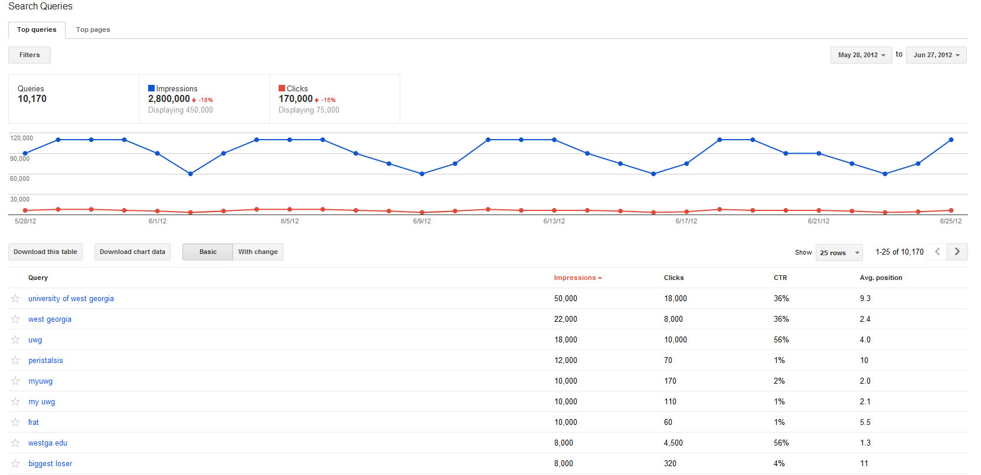
Tracking and Measuring Results
Webmaster Tools
Search Queries
www.google.com/webmasters/tools/
Notes:
Author: Wesley Steverson 07-16-2013

Slide 48
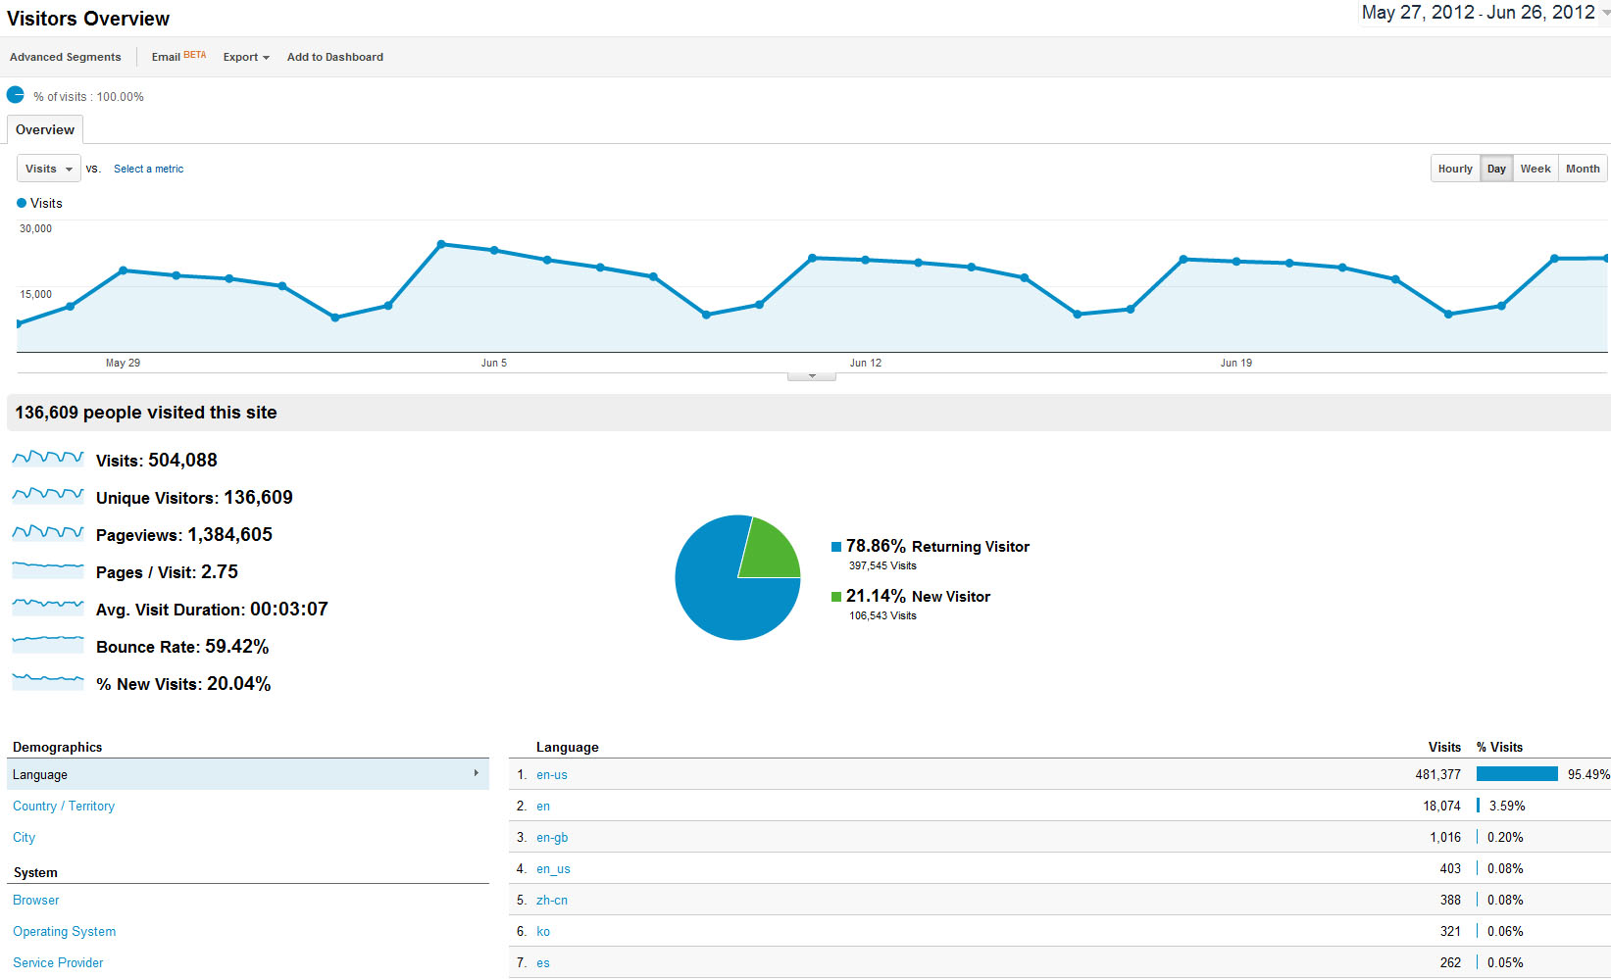
Tracking and Measuring Results – Google Analytics
Visitors Overview
www.google.com/analytics/
Notes:
Author: Wesley Steverson 07-16-2013

Slide 49
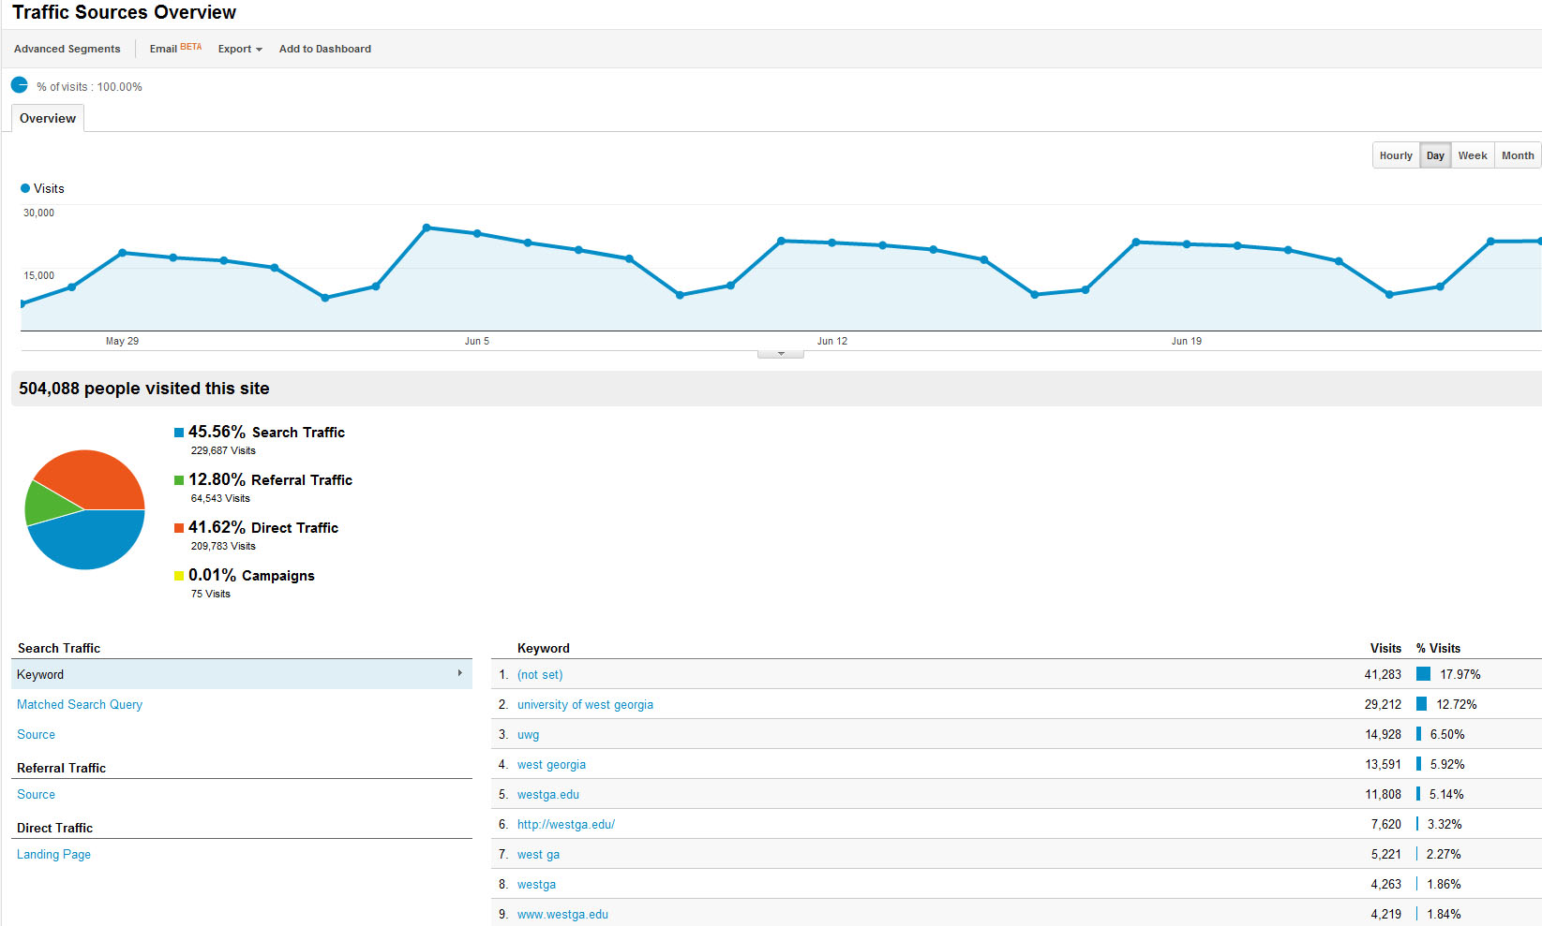
Tracking and Measuring Results – Google Analytics
Traffic Sources
www.google.com/analytics/
Notes:
Author: Wesley Steverson 07-16-2013

Slide 50
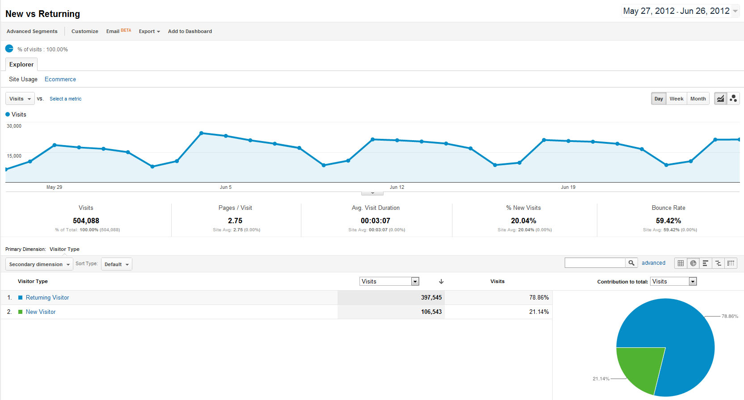
Tracking and Measuring Results – Google Analytics
New vs. Returning
www.google.com/analytics/
Notes:
Author: Wesley Steverson 07-16-2013

Slide 51
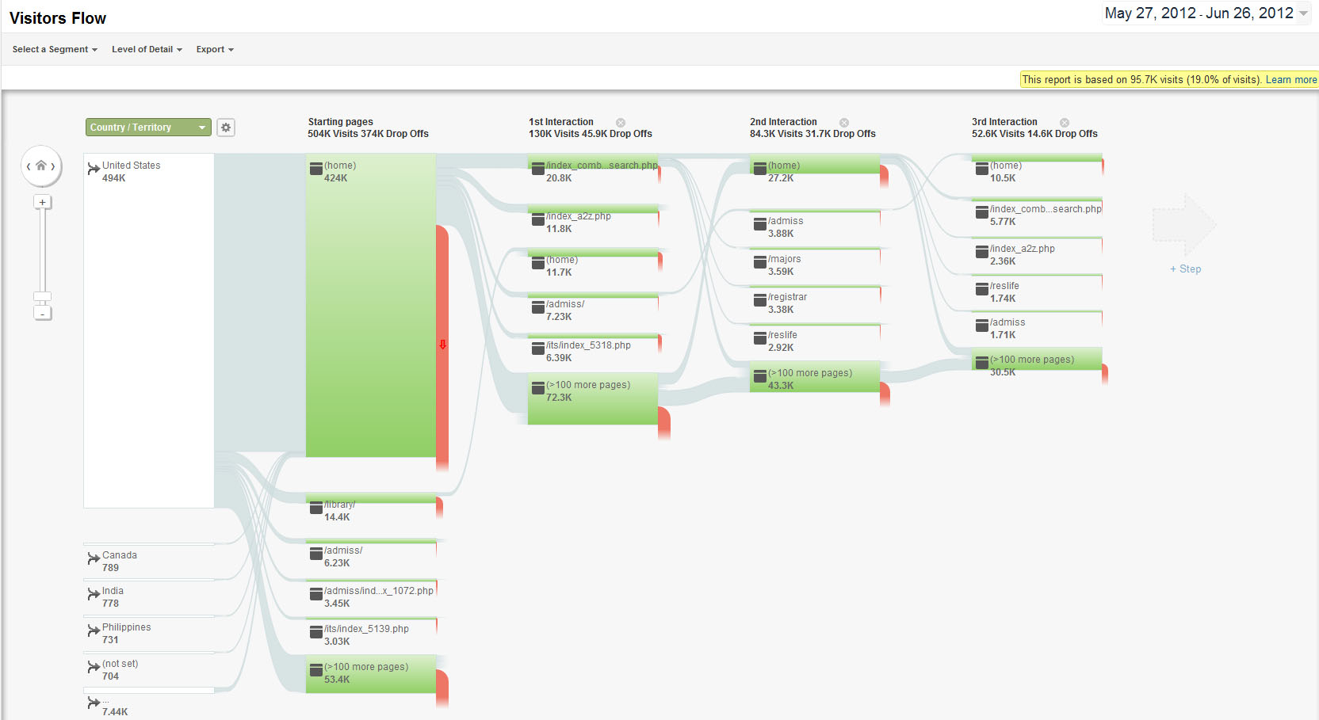
Tracking and Measuring Results – Google Analytics
Visitors Flow
www.google.com/analytics/
Notes:
Author: Wesley Steverson 07-16-2013

Slide 52
Further Information
http://www.google.com/webmasters/tools
http://www.google.com/analytics
https://adwords.google.com/select/KeywordToolExternal
http://www.seomoz.org/tools
http://www.lynda.com
Handley, Ann, and C.C. Chapman. Content Rules: How to Create Killer Blogs, Podcasts, Videos, Ebooks, Webinars (and More) that Engage Customers and Ignite Your Business. Hoboken: John Wiley & Sons, Inc., 2011
Enge, Eric, Stephan Spencer, Jessie Stricchiola, and Rand Fishkin. The Art of SEO: Mastering Search Engine Optimization. O’Reilly Media, 2012
Notes:
Author: Wesley Steverson 07-16-2013

