Slide 1
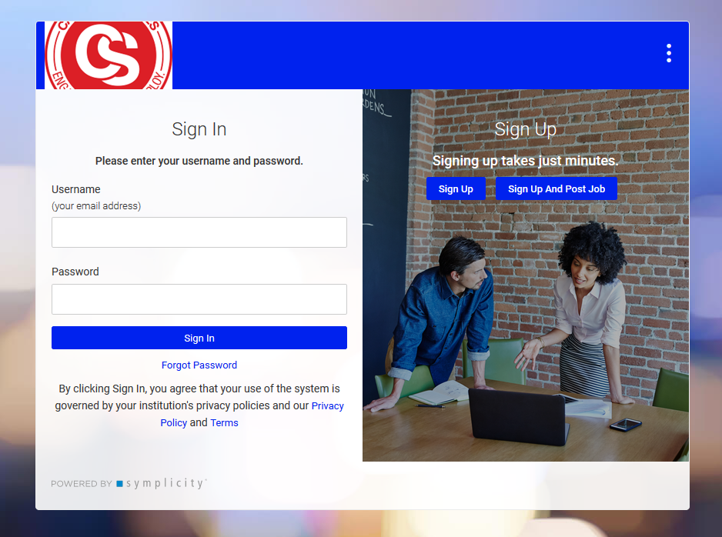
WolfWorks Job Posting Process
First create an account
Account will be approved by Employer Relations
You will receive an email with a link to log into your account.
Dear [fname],
Welcome to WolfWorks, our New On-Line Job Bank and Web-Based Recruiting System.
To access the system, go to [csp_url]employers/.
After logging in, please be sure to fill in your profile. If you are having trouble logging onto the site, please reply to this email.
Your Username is: [email]
[password]
NOTE: This link will expire in 24 hours. If you are unable to set your password within 24 hours, please use the "Forgot Password" link your login page shown above.
Best Regards,
University West Georgia
Career Services
Employer Relations Team
678.839.6431

Slide 2
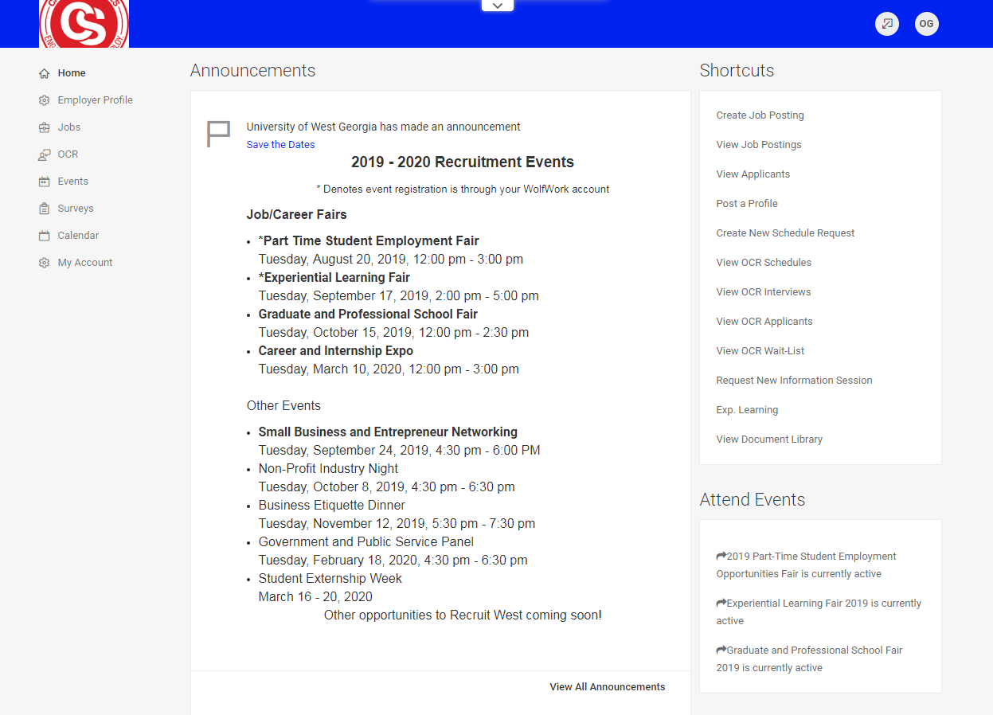
Log in or create WolfWorks account:
https://westga-csm.cymplicity.com/employers
From contact homepage, click Create Job Posting

Slide 3
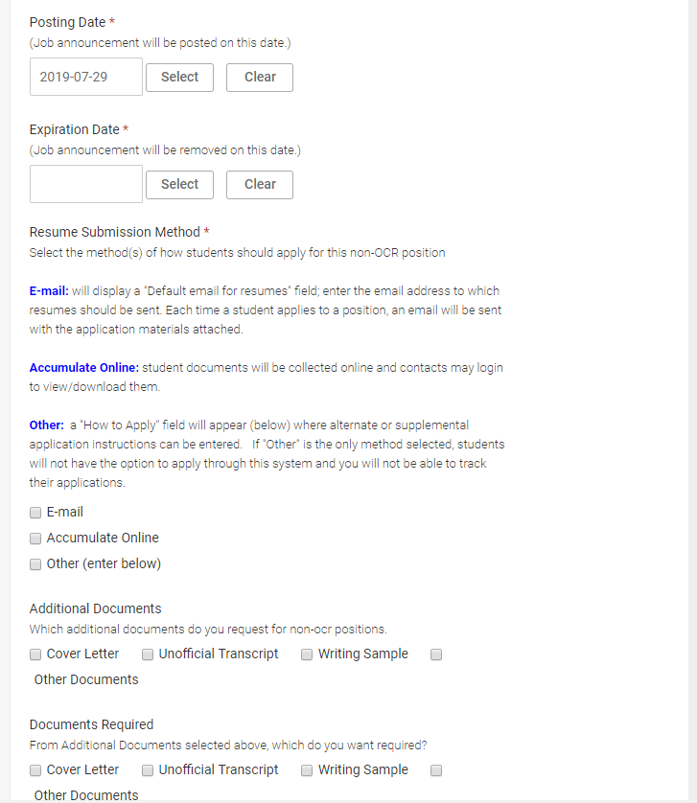
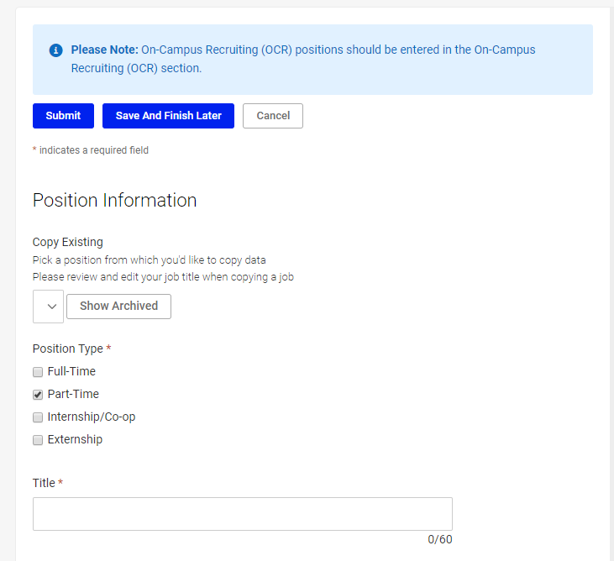
Resume Submission Method:
Select how student will apply:
E-mail – contact will receive an email each time a student applies.
Accumulate Online – contact decides how long they want the resumes to accumulate. System will then send all the resumes to contact in one bundle.
Other – this is usually a link to the job posting in a different system. It can also be another person’s email who will be receiving the applications.
Additional Documents and Documents Required
Do you need any additional information from the student? If so, indicate here. If Other Documents is selected, there is a Requested Document Notes box that follows that allows the contact to explain.
Automatic Application Packet Generation
If yes is selected, contact will receive a copy of all applications with all requested documents when the job closes.
Attachment(s)
Contact can add application or other document.

Slide 4
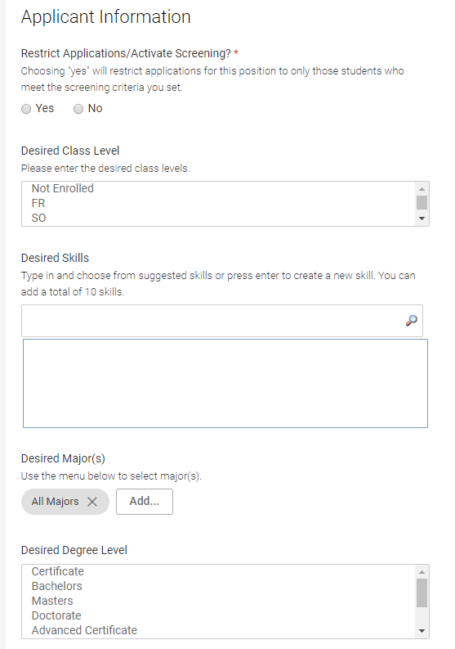
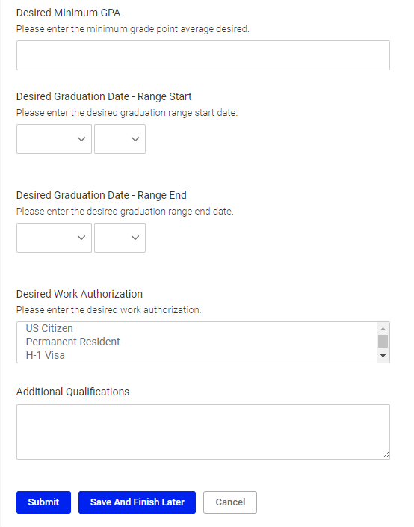
Include as much info as possible in this section.
If you do not care what class level, majors, GPA, etc, you can leave those blank.
Restrict Application/Activate Screening
If you want to restrict your applicants to a particular class, major, GPA, select Yes.
If you will consider any student, select No.

Slide 5
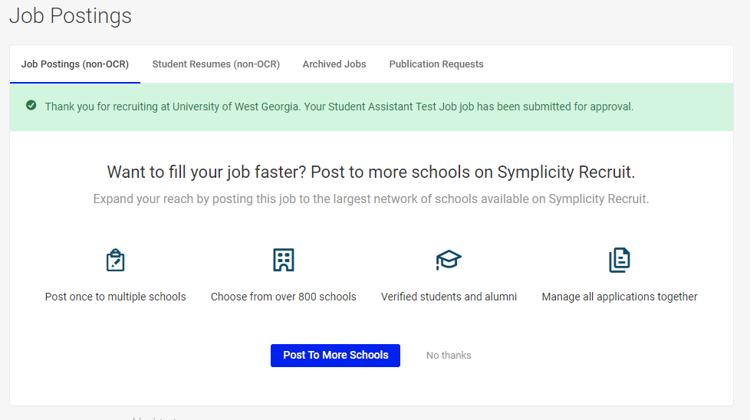
Once job is submitted for approval, contact will see this page and receive an email from hirewest@westga.edu
Thank you for submitting your new "Student Assistant Test Job" job posting request. Your request has been received, and is currently being reviewed. A confirmation email will be sent to your Primary Contact when the request is approved. Until the request is approved, you may review your request and make changes as necessary.
You have elected to receive resumes via: online.
If you have any questions, please contact us.
Thank you,
Employer Relations
UWG Career Services
678.839.6431
Powered By Symplicity
Job will come to Career Services for us to approve. Once job is approved by Career Services, you will receive an email and can view the job by logging into your WolfWorks account.
Dear Name:
The following position has been approved:
Student Assistant Test Job
If students are interested in applying for this position, they will submit their applications to you directly, unless you selected to have applications accumulated on-line in your Symplicity account.
If you have any questions about your job posting, please feel free to contact the UWG Career Services Employer Relations Team.
Thank you for your interest in recruiting our students!
Employer Relations
UWG Career Services
678.839.6431

Slide 6
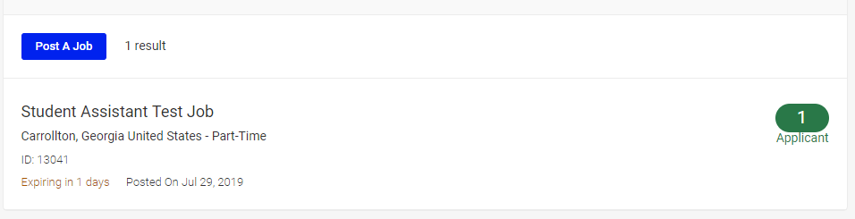
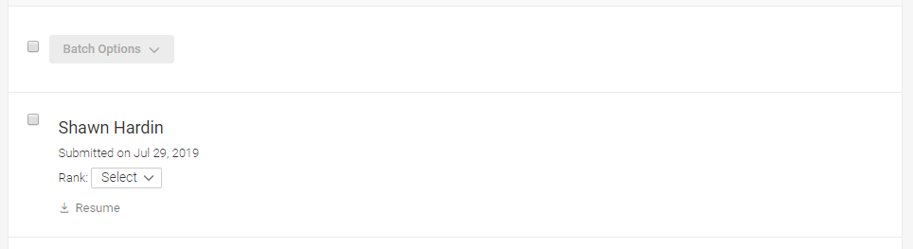
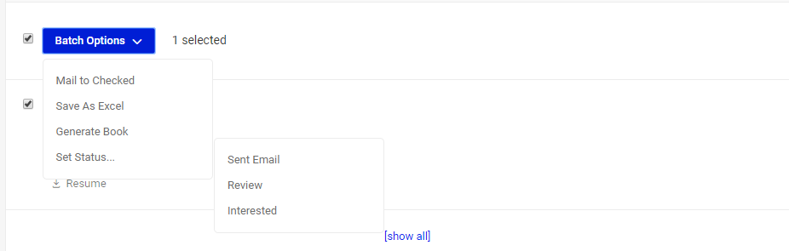
When contact logs in to check applications: Select View Job Posting
This page will show number of applicants. Click on Green Applicant Button.
Shows applicant names. Resumes can be downloaded from this screen.
Click on student name to view resume online.
Select Batch Options and Student Applicants to do the following:
Email students selected to invite to interview, offer job, let them know the job is filled, etc.
Save list of applicants as Excel spreadsheet
Generate resume/application book of selected or all applicants
Set status – you sent applicant an email, you want to review the applicant, you are interested in the applicant.

Slide 7
You will receive an email when job closes/expires
Dear Your Name:
This is an email to let you know that the Job Posting for Student Assistant Test Job has been closed.
Thank you,
Employer Relations
UWG Career Services
678.839.6431
Powered By Symplicity
You will also receive a follow-up email when job closes/expires asking if you hired someone.
Your Student Assistant Test Job Part-Time position expired on Tuesday July 30, 2019. If you have filled this position please provide the information below by simply replying to this e-mail. This will help us improve our joint recruiting efforts. Please be assured that the data you share will be kept confidential.
Did you hire one of our candidates?
Number of candidates hired?
Hourly Wage (If part-time or intern)
Monthly Salary (If full-time)
Major if Available:
Start date of position
End date of position if temporary

